Slide 1


MaCHINE learning Model
Used CARS
Here is where your presentation begins

Slide 2
Table of contents
01
02
03
04
05
06
Import The Data a CSV file
Clean The Data and Organize the columns and It’s Data Types
Try Different Models to Reach higher accuracy
Create a Pickle file to Deployment step
Create an app.py file to start deployment
Deploy using Streamlit

Slide 3


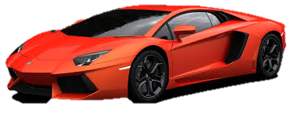

Used Cars Data Ser
Create a Machine Learning model:
Clean The Data and Prepare it for Next Steps
Change datatypes for accurate
Use Different ML models
Use Pipeline to create a pkl file for deploymnet
Deploy the model Using Streamlit

Slide 4
01
Import The Data a CSV file

Slide 5
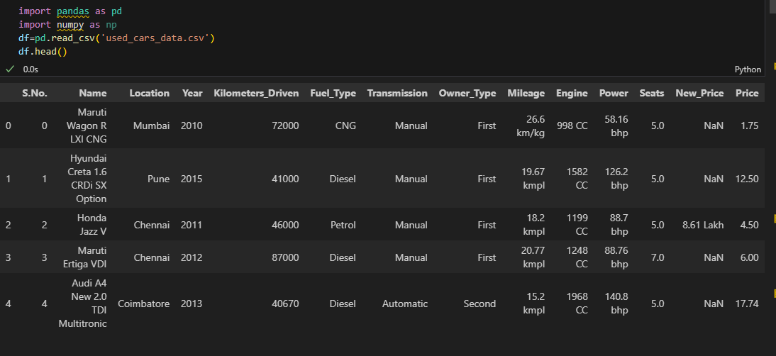
Import The Dataset

Slide 6
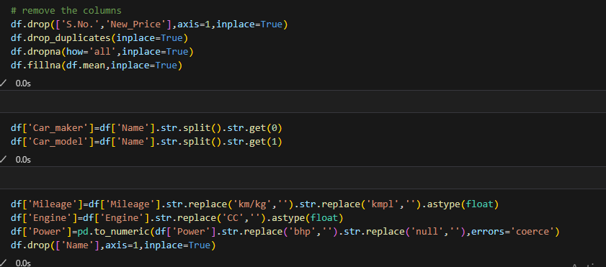
Clean The Data and
Organize the columns
Drop high cardinality columns
(s.no , Name)
Use Name Column to excute Model and Brand Name
Drop new price column because it has high null percentage

Slide 7
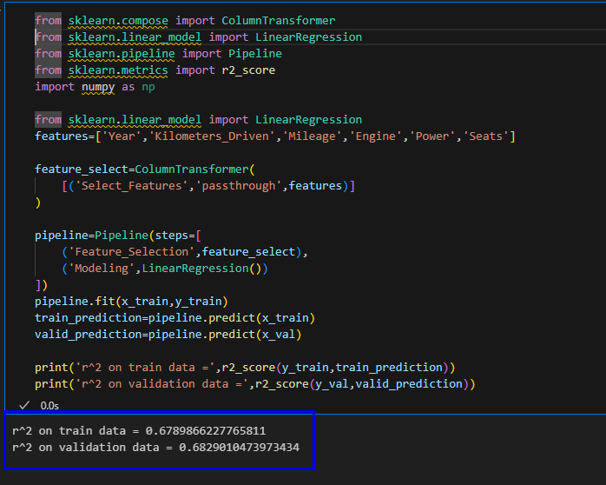
Try Different Models to
Reach higher accuracy
Experiment 1
Linear Regression with Train Test Split Method
This model got
68.2% accuracy

Slide 8
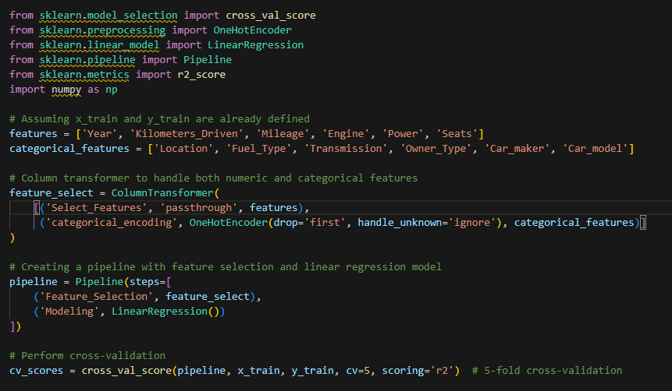
Try Different Models to
Reach higher accuracy
Experiment 2
Linear Regression with Cross Validation
This model got
67.8% accuracy

Slide 9
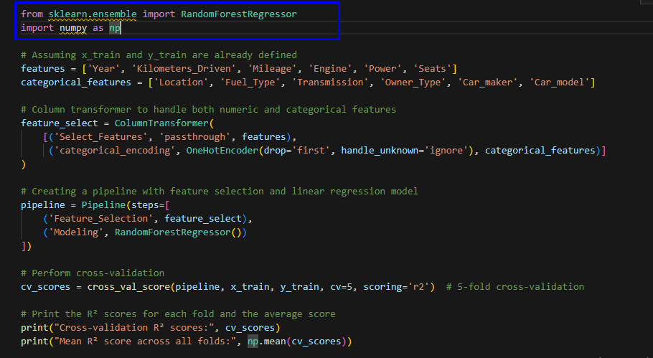
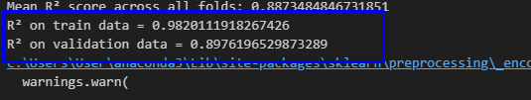
Try Different Models to
Reach higher accuracy
Experiment 3
Random Forest
with Cross
Validation
This model got
89.7% accuracy

Slide 10
Validation
According to Results of experiments we saw that Radom Forest with Cross Validation is the model which will we take to validation step and Deployment

Slide 11
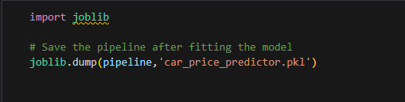
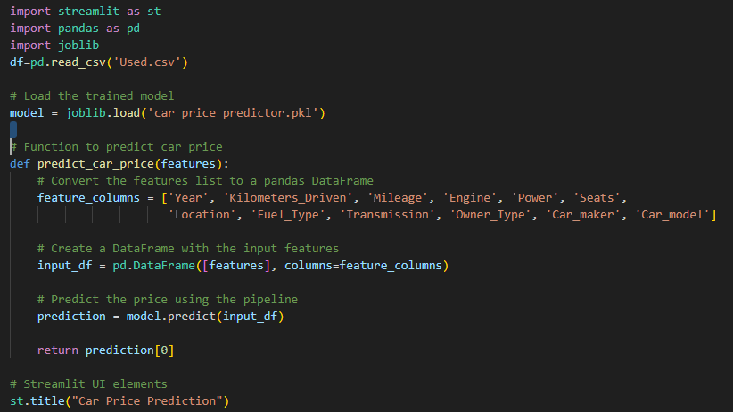
Create an app.py file to start deployment
First we use joblib to save the pipeline process in .pkl file
We use Streamlit for deployment

Slide 12
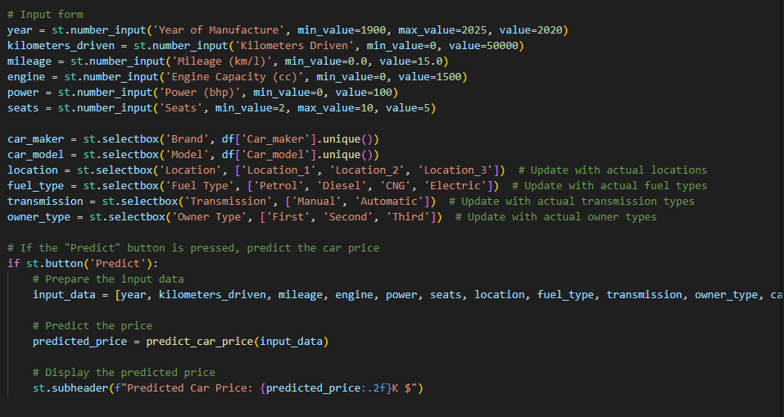
Create an app.py file to start deployment
We put our inputs and set the limits and Values of every input

Slide 13

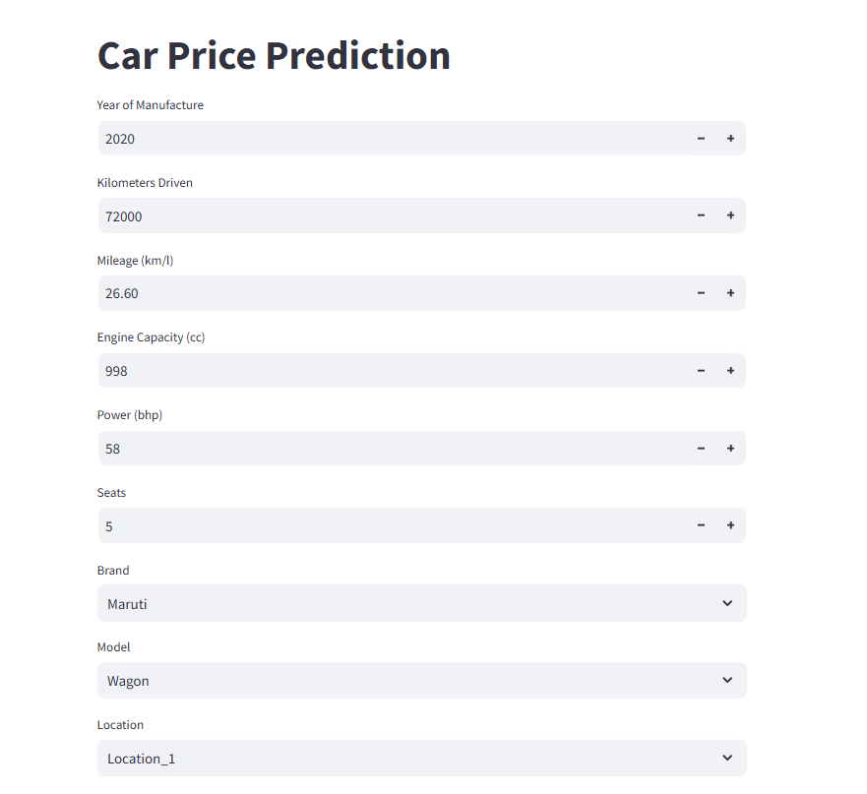
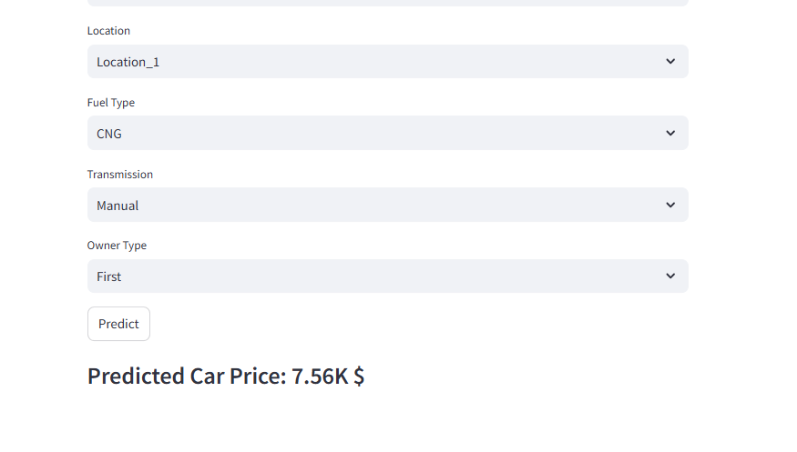

Slide 14
Thanks
Does anyone have any questions?
eng.ahmed.fakhrelden@gmail.com
+20 155 044 8090
https://a-fakhrelden.github.io/Ahmedfakhr/
Please keep this slide for attribution

